Slide 1


2021 Biological Data Science Workshops!
Drexel-Rowan-UChicago

Slide 2

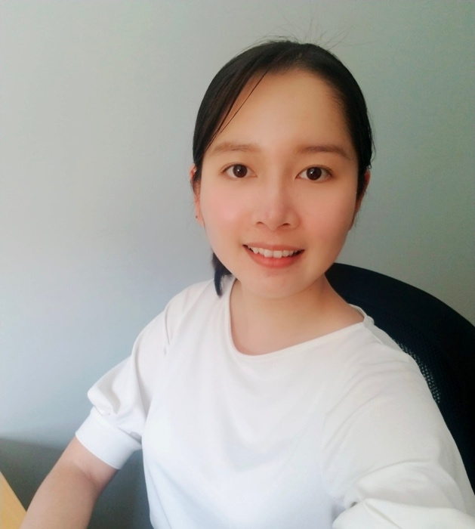
Drexel University Team
Bash/Unix:
Working w/ NCBI
Mali Halac, Electrical Eng.
Kenn Chong, Computer Science
Dr. Gail Rosen, Elec. & Comp. Eng.
Implementations of Deep Learning
Distributed Computing - SLURM
Dr. Bahrad Sokhansanj, Engineering & Law
Thomas Coard, Bioinformatics
Hoang Oanh Pham, Computer Science

Slide 3
University of Chicago
Make & AWS Containers
Dr. William Trimble, Computer Science

Slide 4
Rowan University Team
Foundations of Machine Learning
Dr. Robi Polikar, Elec. & Comp. Eng.
Emrecan Ozdogan, Electrical Eng.

Slide 5
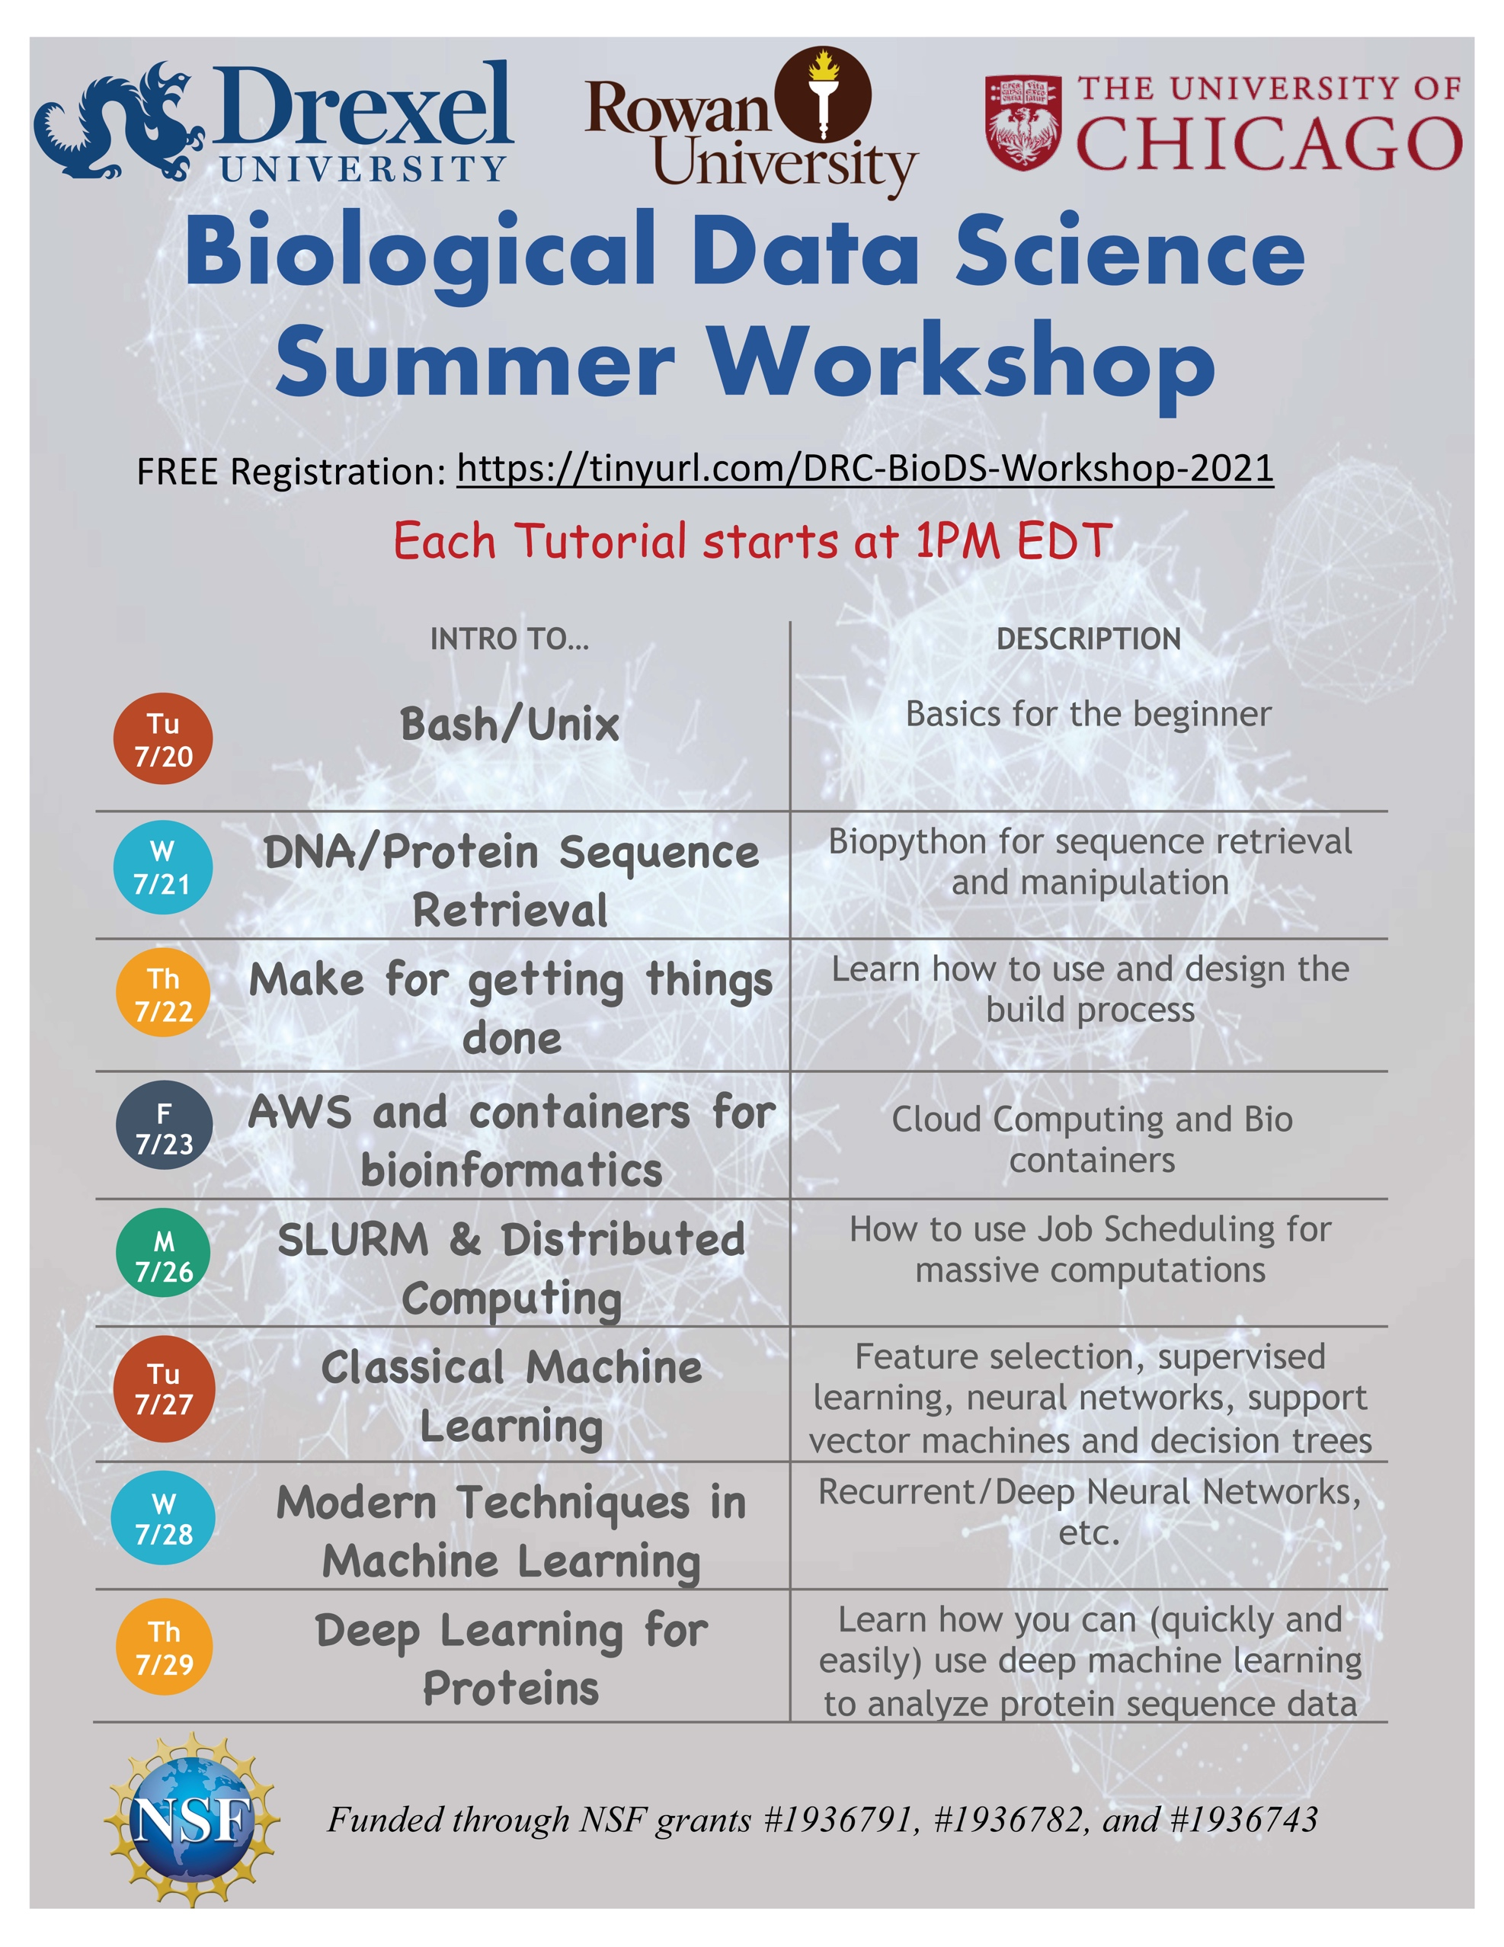
Enjoy the workshop!
Thanks to the team and the National Science Foundation!

